Slide 1


Bachelors Degree Majors
Mahesh Utlapalli,
Krishna Chaitanya Yejju
Guru Datta Abhishek Yejju,
Tejas Patel
This Photo by Unknown Author is licensed under CC BY

Slide 2
CONTENT
Problem Statement
Visualization
Machine Learning models applied on dataset are:
Classification:
Decision Tree
Naive Bayes
Clustering:
K-Means
Regression:
Logistic Regression
Conclusion

Slide 3
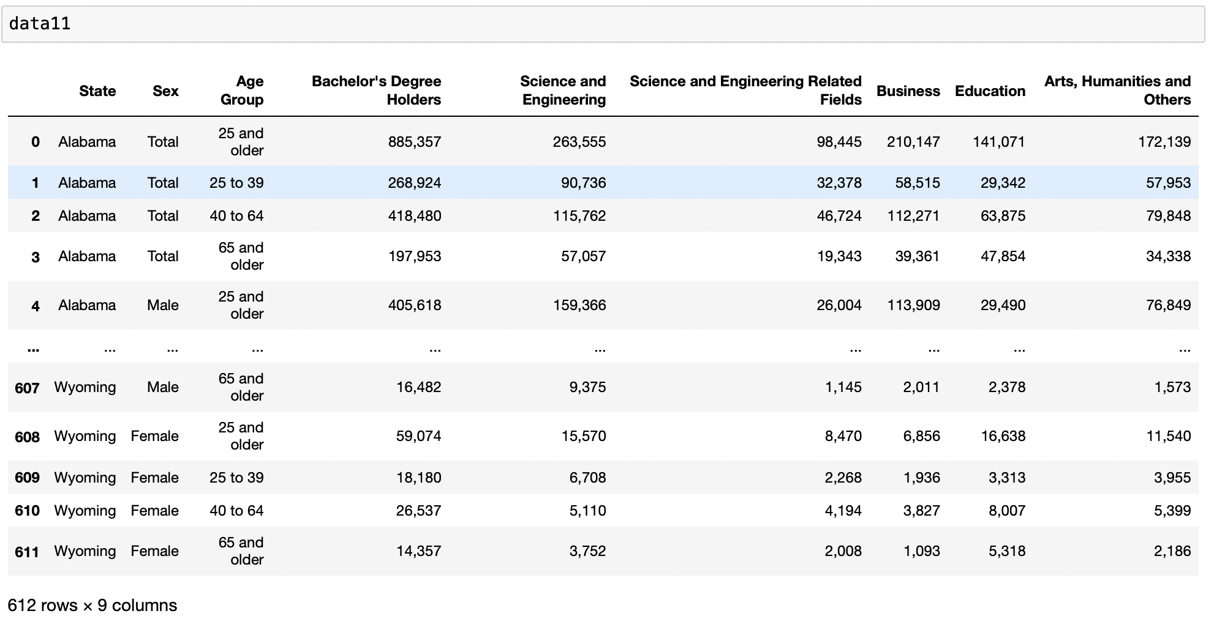
PROBLEM STATEMENT
This project aims to apply Machine learning models to predict Sex (Male, Female) based on the different columns used in the dataset.
Dataset:
Number of instances: 612; Number of attributes: 9

Slide 4
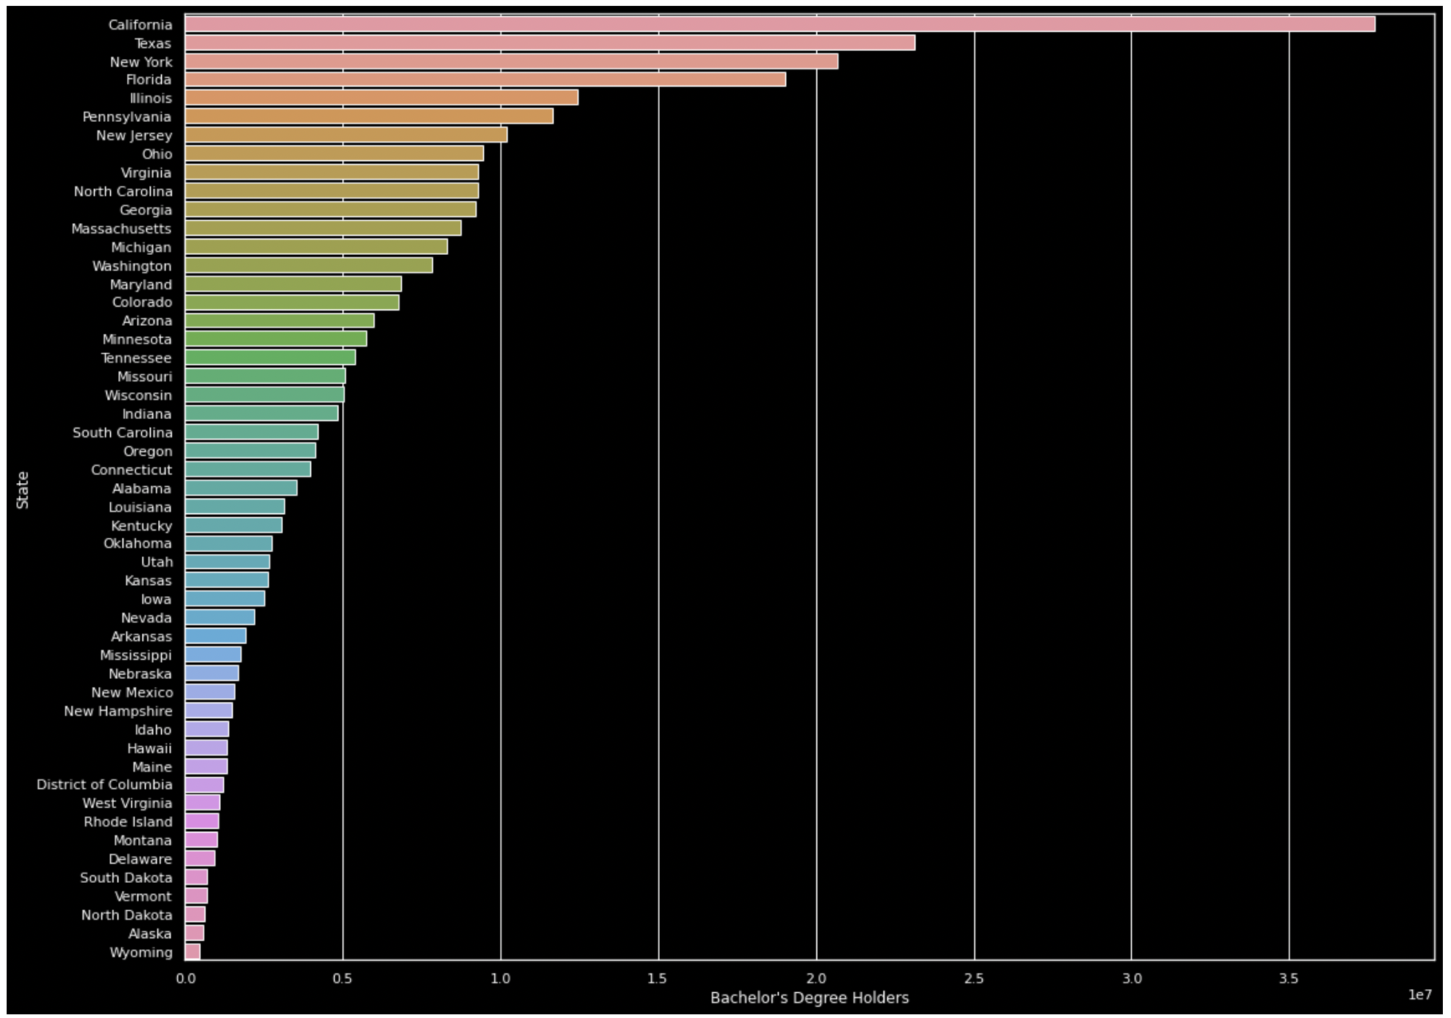
Visualization
Number of bachelor's degree holders by states

Slide 5
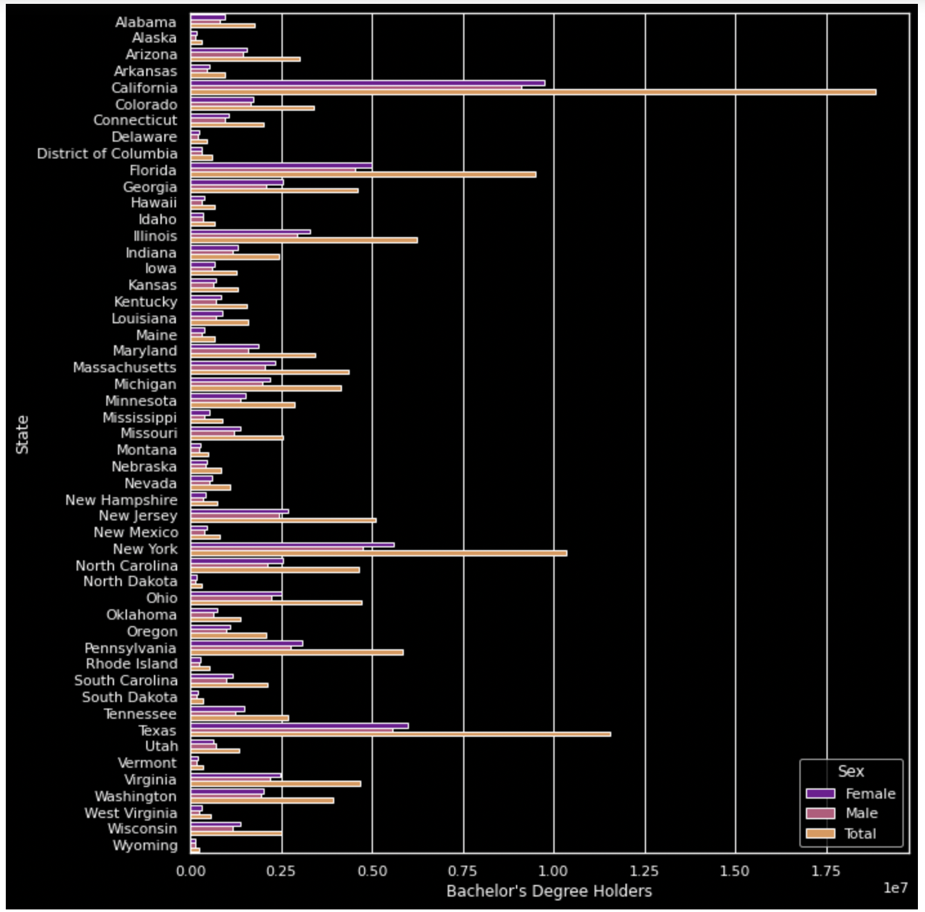
Continuation…
Number of bachelor's degree holders by states based on sex

Slide 6
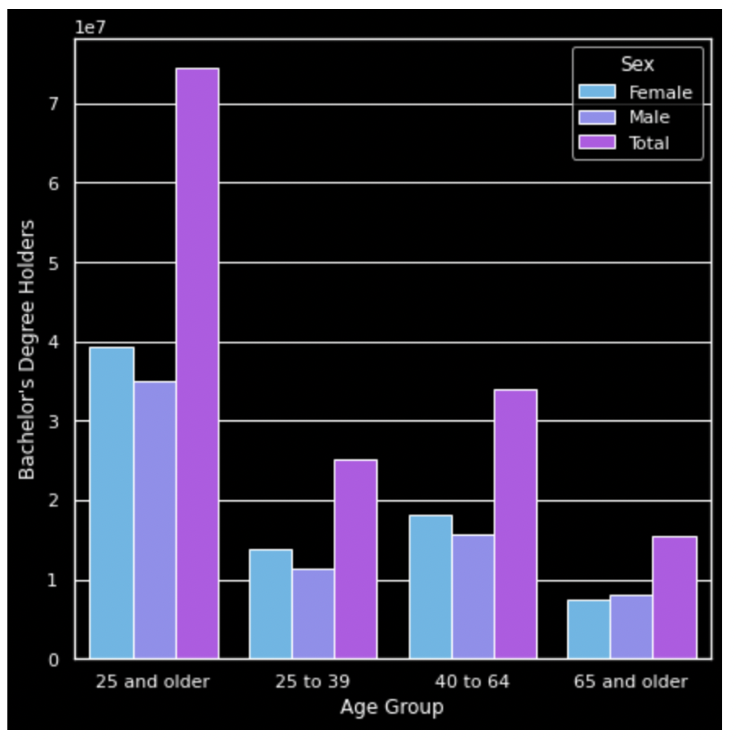
Continuation…
Number of females, males, and total based on age group

Slide 7
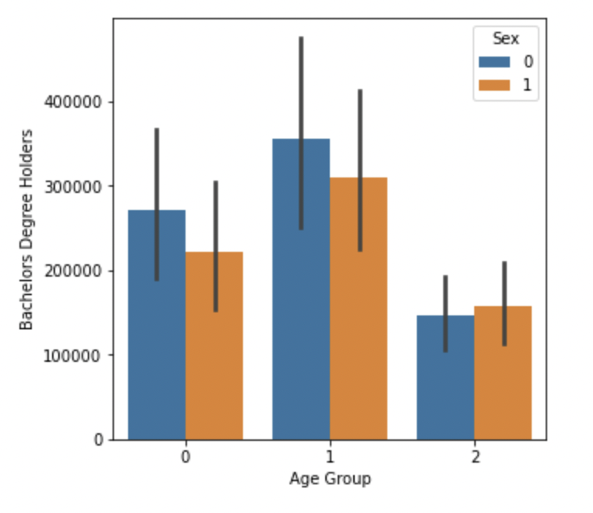
Continuation…
Graph shows which gender (Female, Male) have more Degree Holders

Slide 8
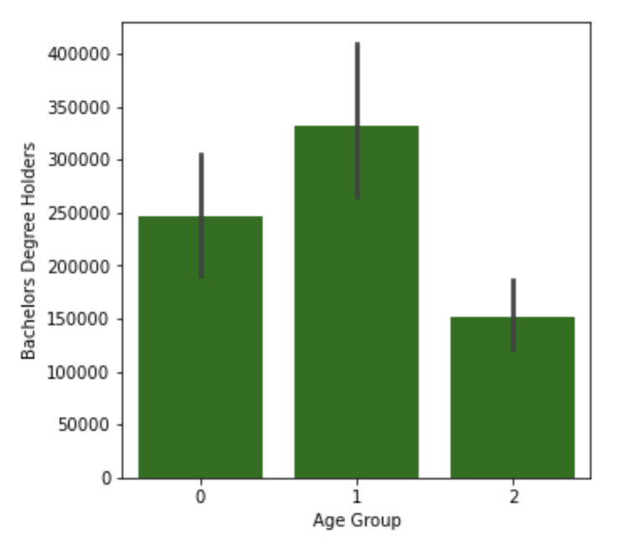
Continuation…
Graph shows which age group has more Degree Holders

Slide 9
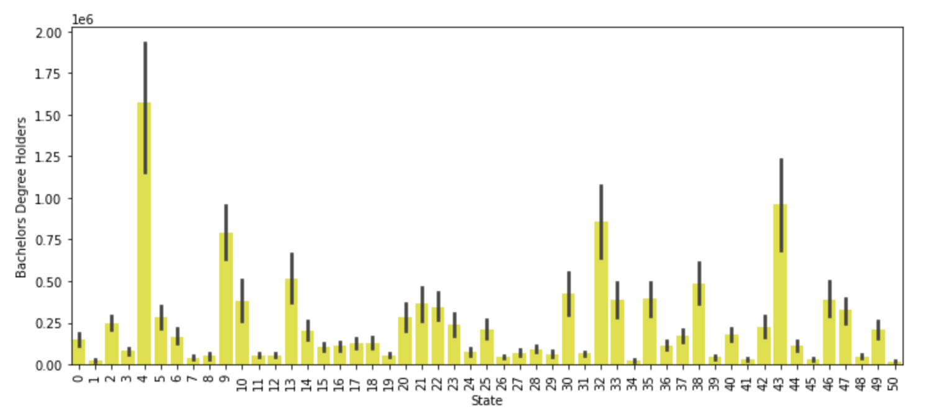
Continuation…
Barplot of which state has more degree Bachelors Degree Holders

Slide 10
Naive Bayes Classification
Naïve Bayes algorithm is a supervised learning algorithm, which is based on Bayes theorem and used for solving classification problems.
It is mainly used in text classification that includes a high-dimensional training dataset.
Naïve Bayes Classifier is one of the simple and most effective Classification algorithms which helps in building the fast machine learning models that can make quick predictions.
It is a probabilistic classifier, which means it predicts on the basis of the probability of an object.
Some popular examples of Naïve Bayes Algorithm are spam filtration, Sentimental analysis, and classifying articles.

Slide 11
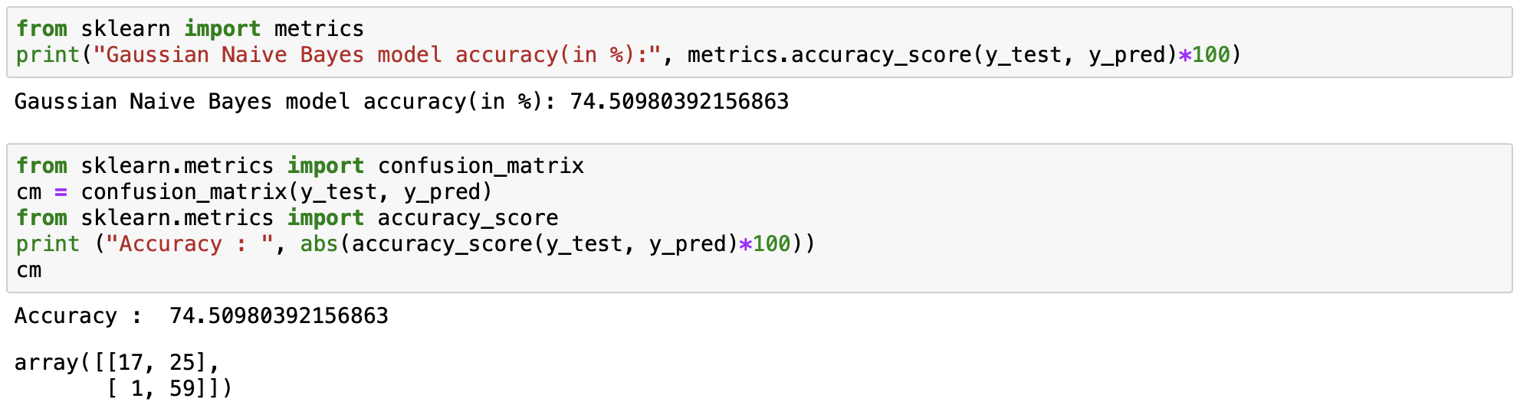
Accuracy and Confusion Matrix

Slide 12
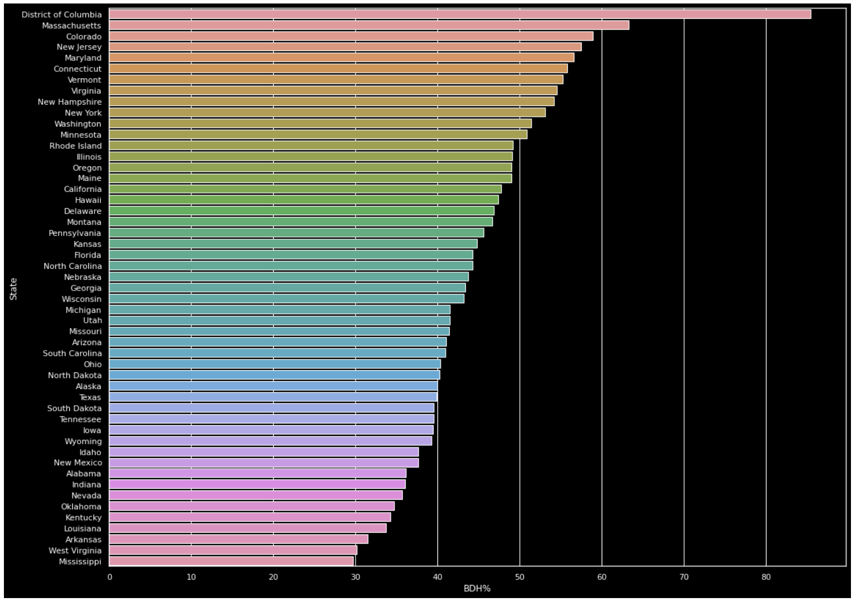
Comparing the percentage of bachelor's degree holders per population by states

Slide 13
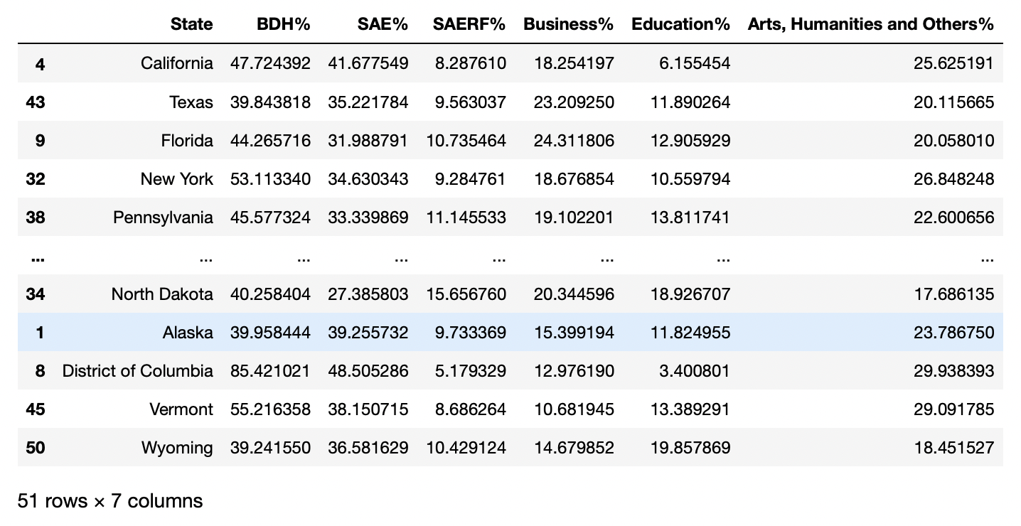
Percentage of all bachelor degree holders per population by states

Slide 14
Advantages:
The assumption that all features are independent makes naive bayes algorithm very fast compared to complicated algorithms. In some cases, speed is preferred over higher accuracy.
It is easy and fast to predict the class of the test data set. It also performs well in multi-class prediction.
Disadvantages:
The assumption that all features are independent is not usually the case in real life so it makes naive bayes algorithm less accurate than complicated algorithms. Speed comes at a cost!
On the other side naive Bayes is also known as a bad estimator, so the probability outputs are not to be taken too seriously.
Limitation:
Naive Bayes is the assumption of independent predictors. In real life, it is almost impossible that we get a set of predictors which are completely independent.

Slide 15
Applications
Real time Prediction
Multi class Prediction
Text classification/ Spam Filtering/ Sentiment Analysis
Recommendation System
Credit Scoring
Medical Data Classification

Slide 16
What is classification
Classification algorithms in machine learning use input training data to predict the likelihood that subsequent data will fall into one of category.
We use decision tree classifier for our Bachelor Degree Majors data set it is a supervised learning and its perfect for classification problems.

Slide 17
About Decision Tree
It works like a flow chart, separating data points into two similar categories at a time from the tree trunk to branches then to leaves, where the categories become more finitely similar.
A decision tree consists of two types of nodes
- Decision nodes
- End nodes or Leaf nodes

Slide 18
CART Algorithm
Decision tree algorithm CART uses the Gini method to create split points.
CART is a binary tree build by splitting node into two child nodes repeatedly based on a threshold value of an attribute with the help of the Gini Index criterion.
Sklearn supports Gini criteria in decision tree classifier for Gini Index and by default it takes Gini value, and it favours larger partitions also it is easy to implement.

Slide 19
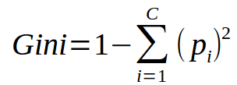
Calculating Gini
Gini is calculated by subtracting the sum of the squared probabilities of each class from one
More Gini Index = More Impure Class(1 Impure Class)
Less Gini Index = More Pure Class
Gini Index = 0(Pure class) i.e. Its a Leaf node and further Can't be Split.

Slide 20
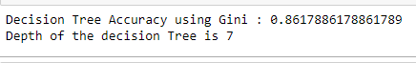
Accuracy
We applied decision tree classifier on the Bachelor Degree Majors data set of accuracy is 86.1% and Depth of decision tree is 7.

Slide 21
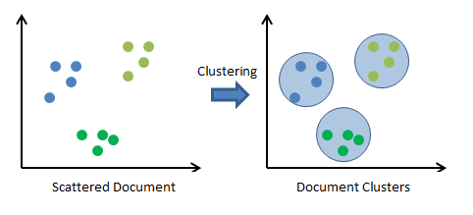
Clustering
Clustering refers to the process of automatically grouping together data points with similar characteristics and assigning them to “clusters.” Some use cases for clustering include: Recommender systems (grouping together users with similar viewing patterns on Netflix, in order to recommend similar content).

Slide 22

K-Means
K-Means is a method that aims to partition ’n’ observations into ‘k’ clusters in which each observation belongs to the cluster with the nearest mean.

Slide 23
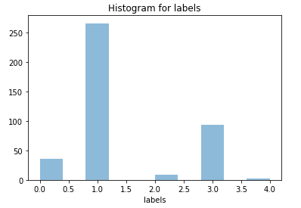
Plotting
A histogram is a bar graph-like representation of data that buckets a range of outcomes into columns along the x-axis
To summarize discrete or continuous data we used Histogram

Slide 24
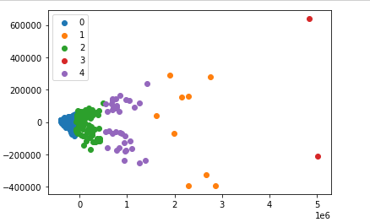
2D scatter plot for all clusters based on PCA algorithm
VISUALISING THE CLUSTERS USING SCATTER PLOT

Slide 25
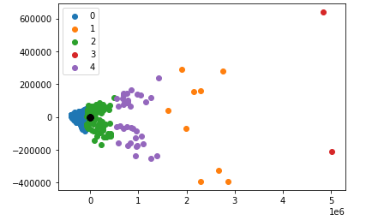
Plotted centroid for all the clusters
The Centroid only for one cluster

Slide 26
Advantages
Easy and simple to implement
Generalizes to clusters of different shapes and sizes, such as elliptical clusters
Disadvantages
Choosing k manually
Being dependent on initial values

Slide 27
Logistic Regression
Regression analysis is a process of predicting a dependent variable from one or more independent variables.
We applied Logistic Regression to our dataset. Logistic Regression is best to apply when the dependent variable is binary such as pass-fail, win-lose, alive-dead, healthy-sick, yes-no.
Here We used it to predict whether the Bachelors Degree Holders are Male or Female.

Slide 28
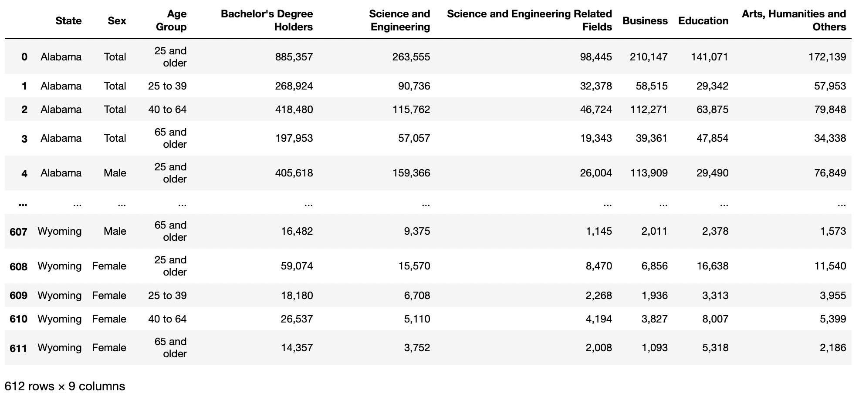
Raw Data

Slide 29
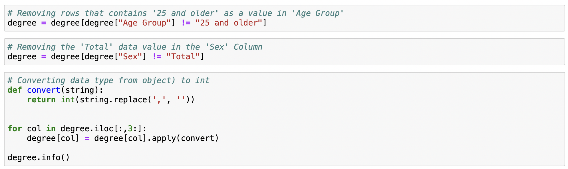
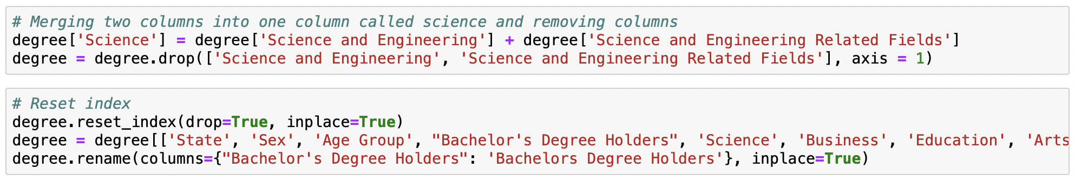
Data Preprocessing

Slide 30
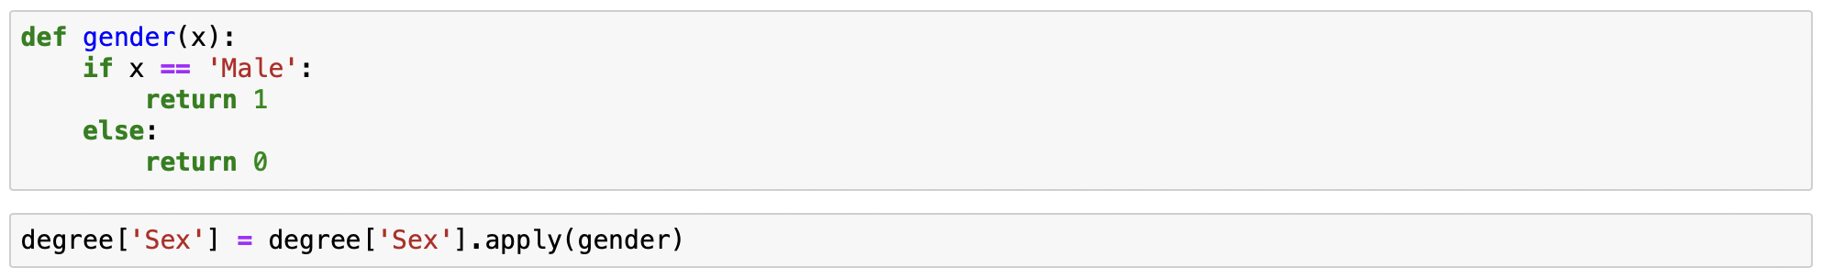
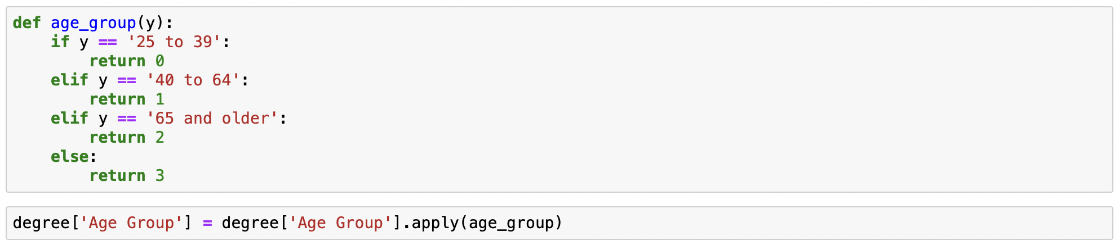
Continuation…

Slide 31
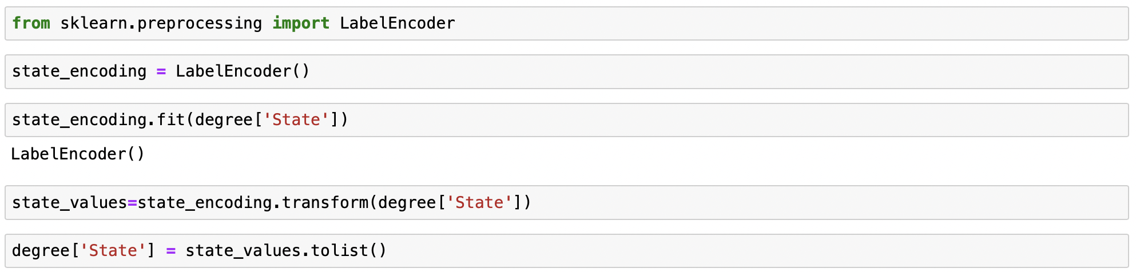
Continuation…

Slide 32
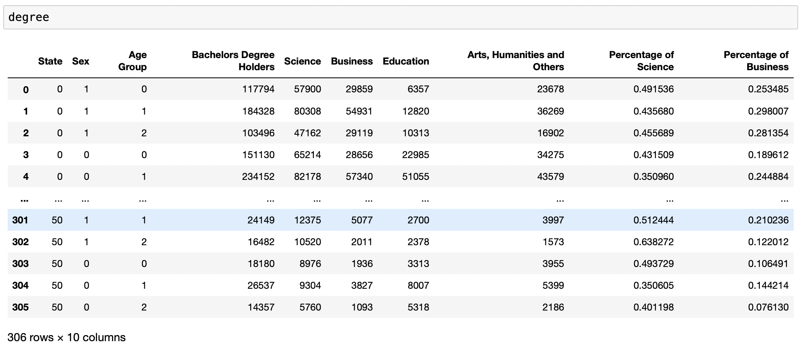
Cleaned Data

Slide 33
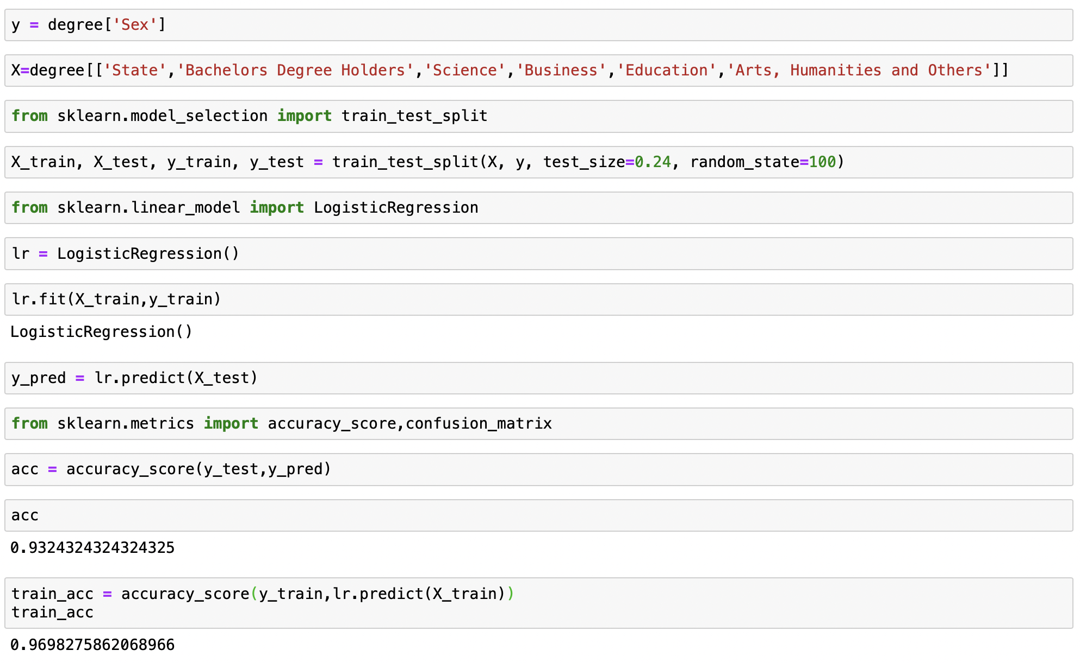
Applying Logistic Regression

Slide 34
Advantages
Good accuracy for many data sets and it performs well when the dataset is linearly separable.
The training time of the logistic regression algorithm comes out to be far less than most complex algorithms, such as an Artificial Neural Network.
Disadvantages
It is difficult to capture complex relationships using logistic regression.
Non-linear problems can't be solved with logistic regression.

Slide 35
Conclusion
We have used different algorithms like decision tree, naïve Bayes classification, K-Means clustering and lastly logistic regression in those algorithms the Accuracy of the Logistic Regression algorithm is comparatively more than other algorithms. From this, we can conclude that the prediction of Gender (Male, Female) is easy when comparing with age group and state because when we predict the gender after pre-processing of our dataset there are only binary values either 0 or 1. so this makes the more accuracy occurred in the logistic regression algorithm.

Slide 36
Future Scope
We used different algorithms like decision tree and naïve bayes classification, K-Means clustering and lastly logistic regression, but we will be using the other algorithms like ID3, MARS,C4.5 and CHAID, where we could have compared the accuracy.

Slide 37


